Slide 1

Online Pharmacy
User Interface Design and Testing
@ Q-TECH
NANXI LI, YUE XING,
JIAWEN ZHU, NAMITA SIBAL, JAMES DEVUYST

Slide 2

The final Prototype of UPMC Pharmacy Website
Changes according to Expert Feedback
Changes according to User Feedback
Summary

Slide 3
Prototype Show time
1
This is the Final Design of the website.
Show some Special Features of our website.

Slide 4


Notes:
1add one line

Slide 5
Expert Feedback
2
changes made according to the heuristic analysis
Notes:
mention where the problems mainly are

Slide 6

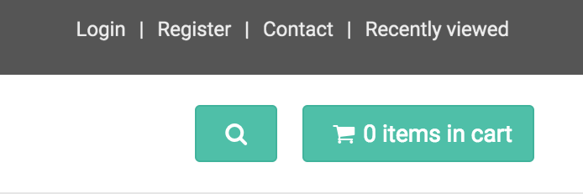
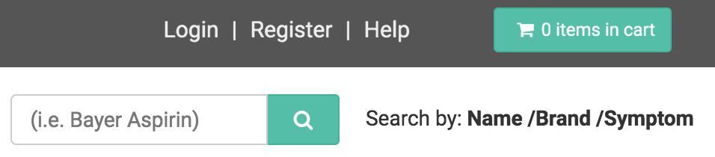

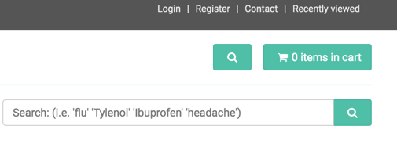
Home Page
Step1:
Step2:
Show the search bar directly
The Search bar only appears after user clicks the small “search” icon.

Slide 7
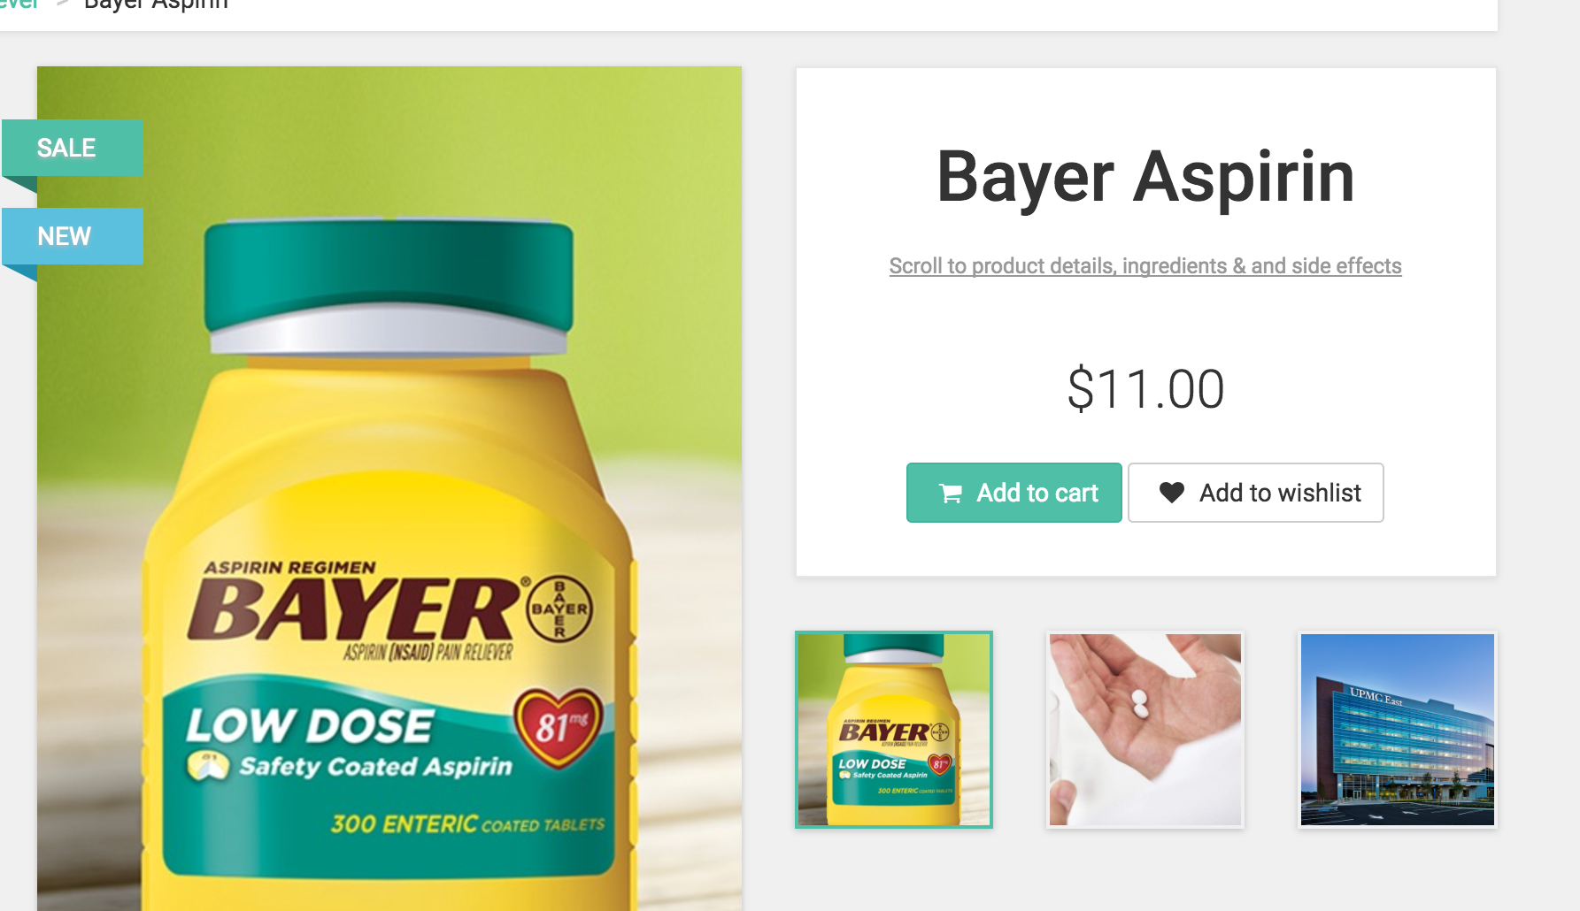
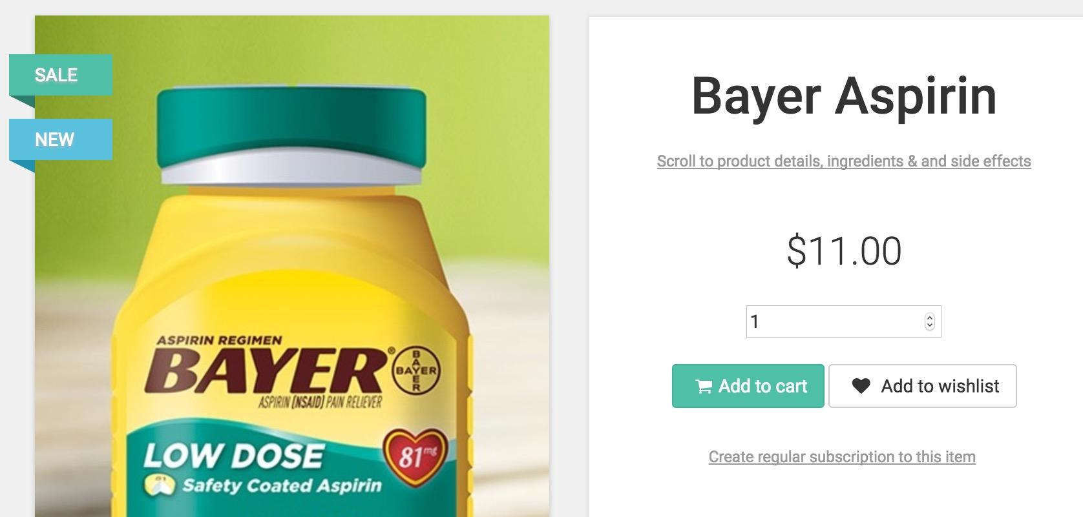
Product Page
It will be too bothersome for users to change quantity only in cart.
Add a selection box
Notes:
mention it is not our final version, and we will add rating of review here after doing the user test.
Default value is 1.

Slide 8

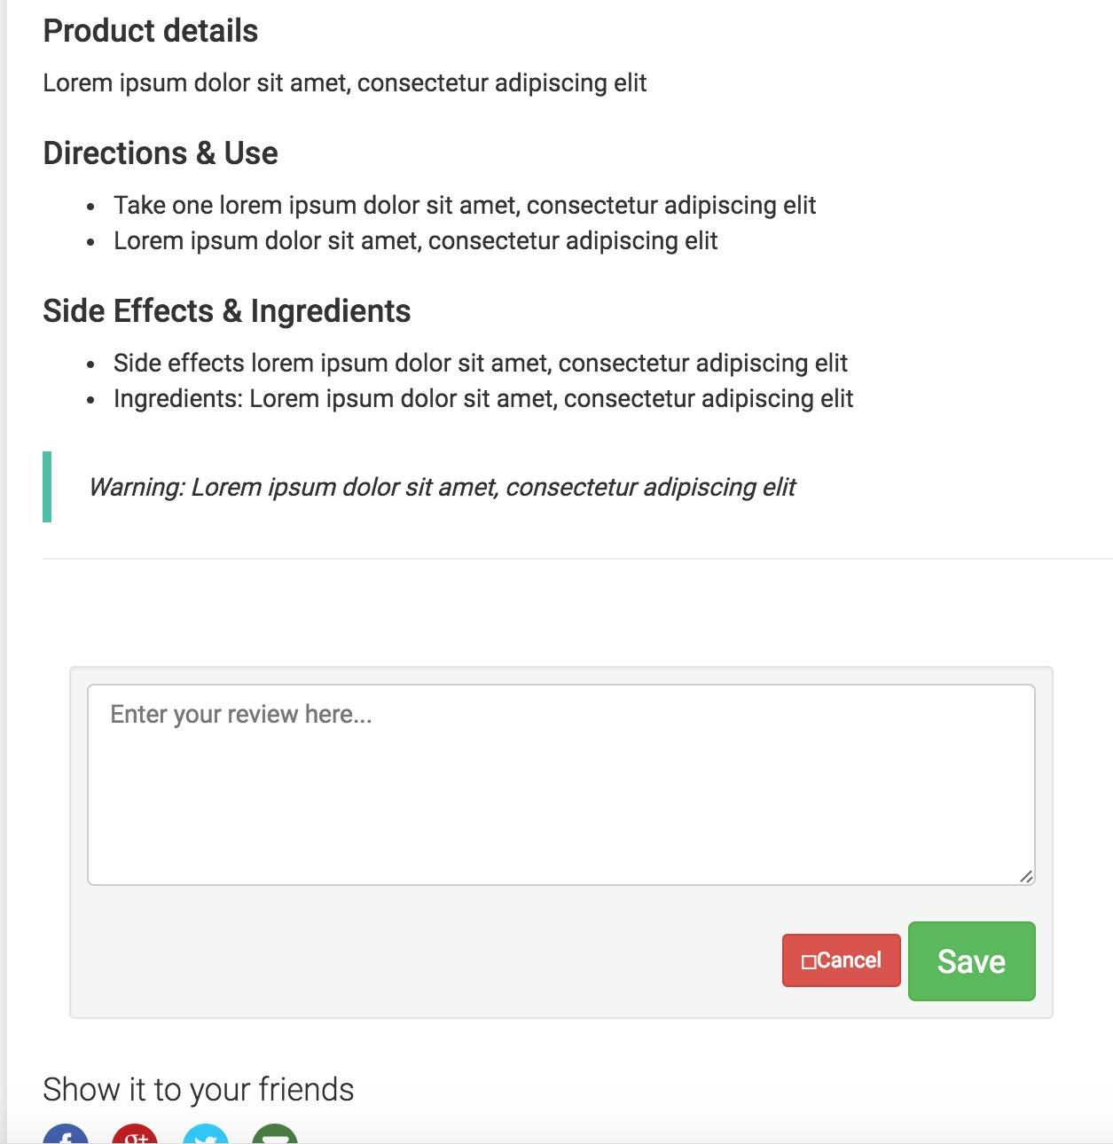
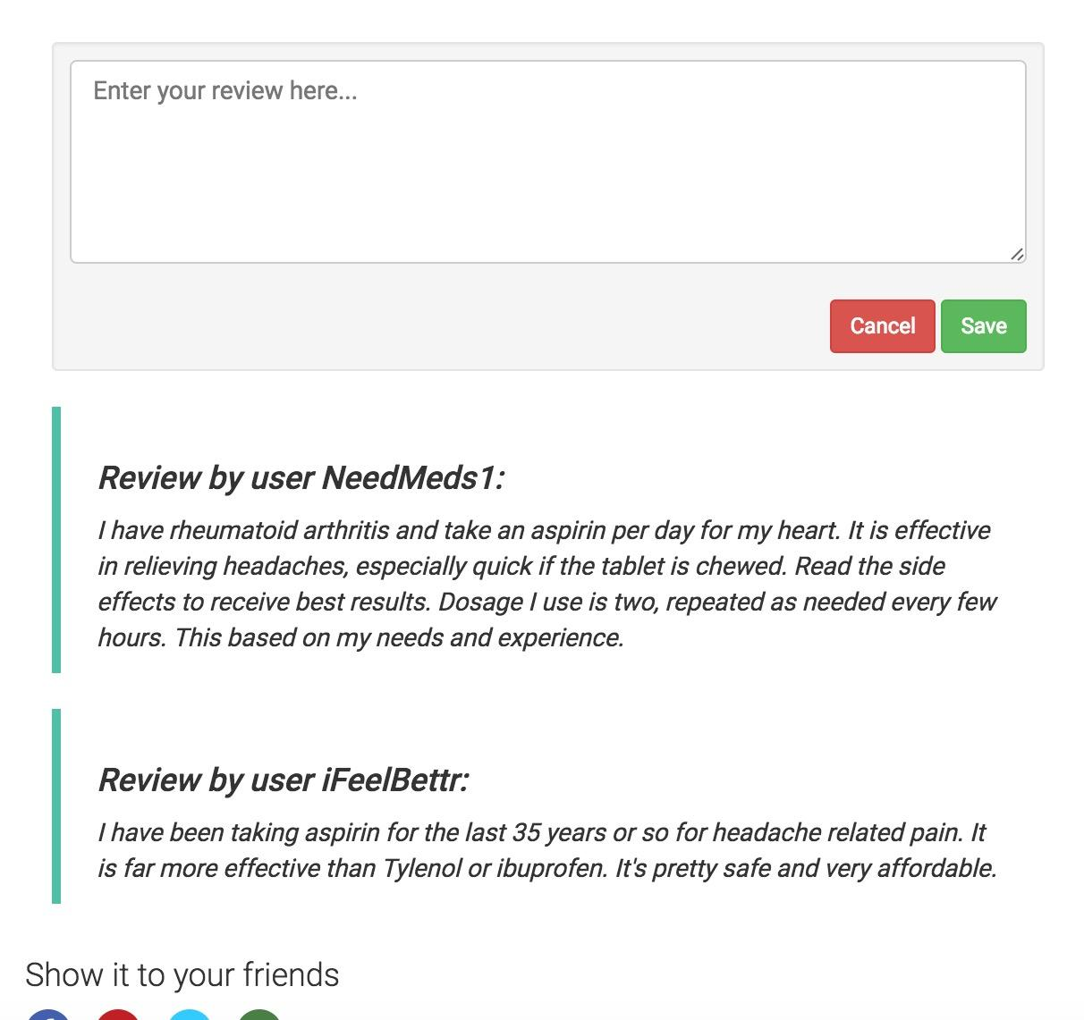
Product Page
Users can not see reviews from other customers, and they can only input review.
Notes:
Cancel button

Slide 9
User Feedback
3
changes made according to two users’ feedback

Slide 10



• Freshman in CMU
• Do online shopping often
• 50 plus middle aged
An administrative staff
• Seldom do online shopping
Notes:
Our elderly user is a women in her early 50s and works for the Osher Lifelong Learning Institute at CMU. She mainly manages setting up user accounts and handles the emails for the institute. She is skilled in terms of using the computer and internet. But, she rarely shops online. Specially, she has never bought any medicine online. She is best suited for our study, since her insights about the website will be informative and experienced.

Slide 11
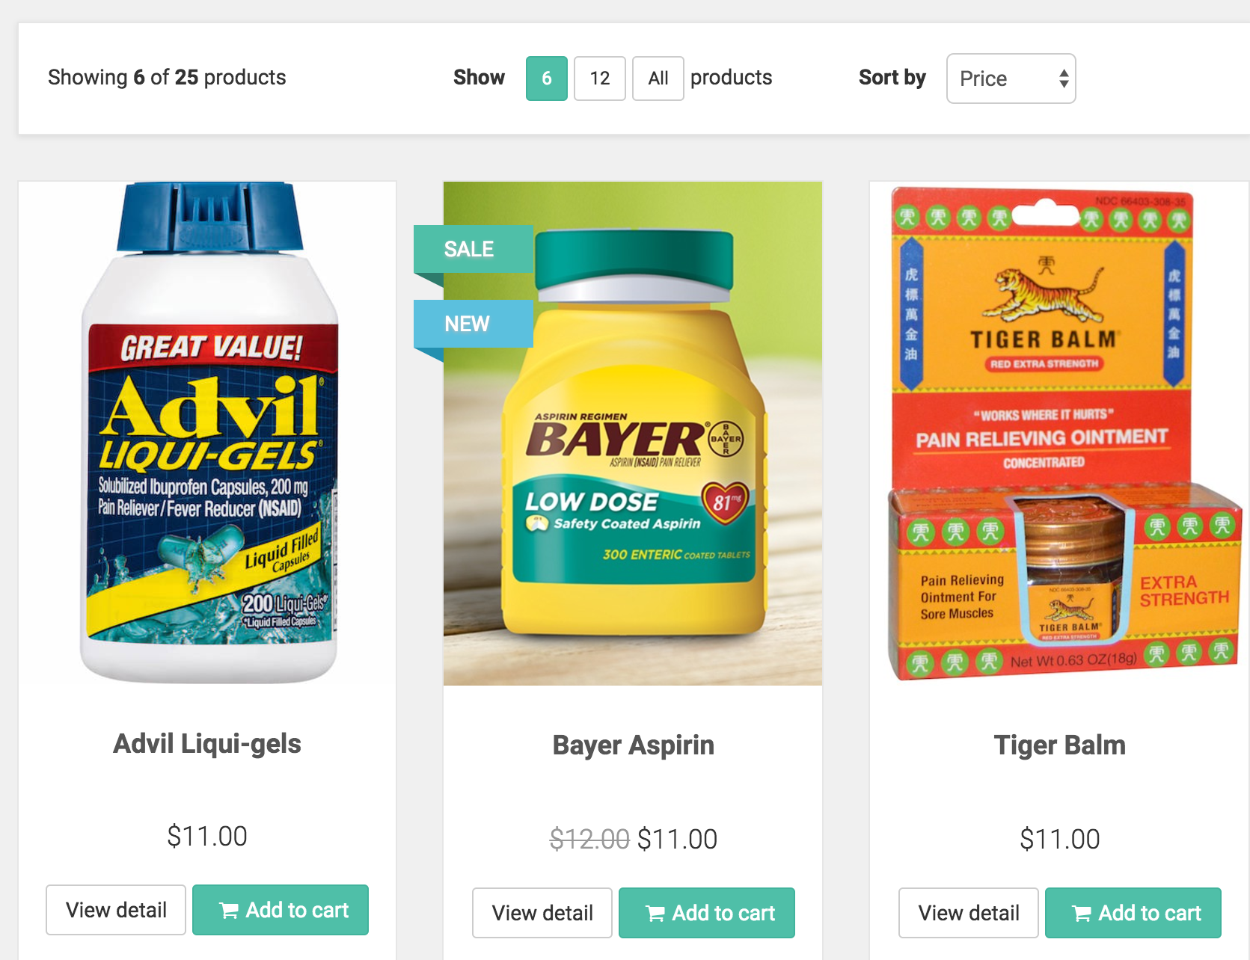
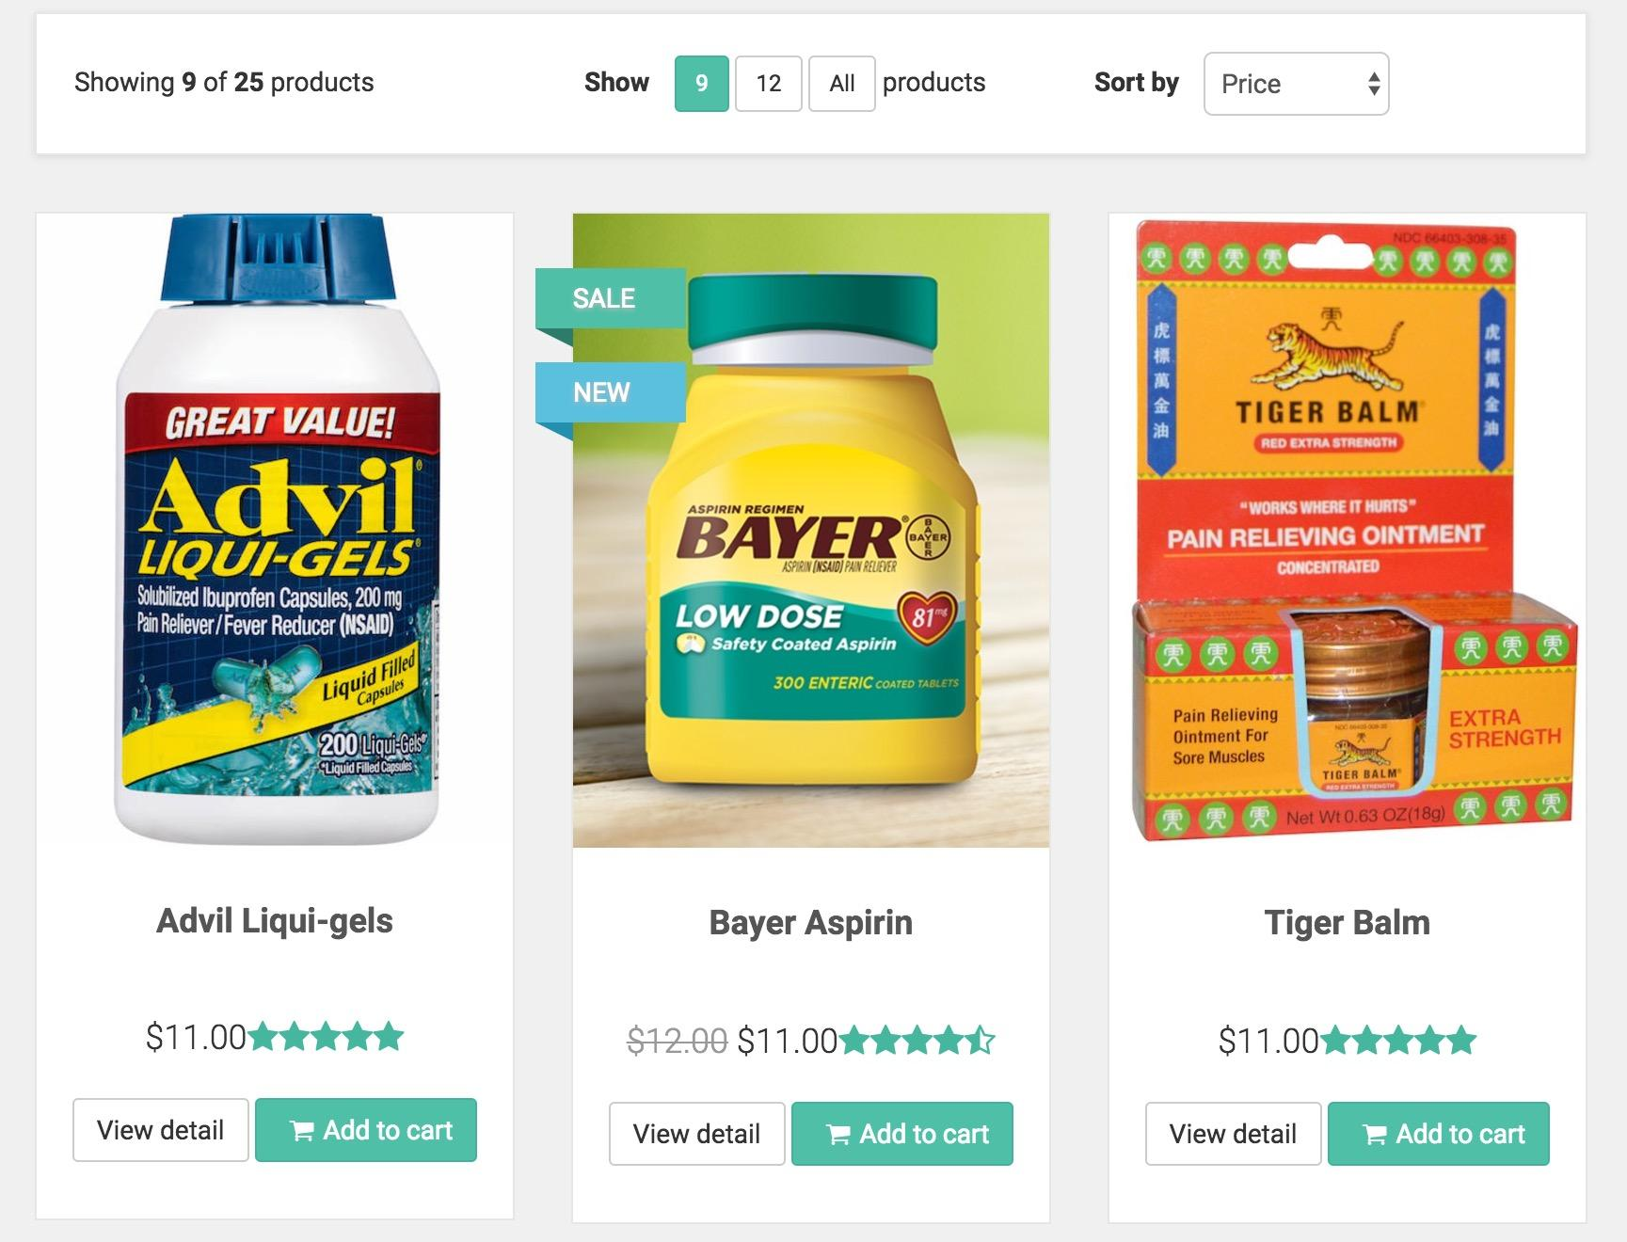
Category Page
Have No ratings
Notes:
Reviews are present for each product but ratings are not specified. Easy understandability of the product is ensured if rating is present.
It is not that critical, because on the reading the reviews eventually users can figure it out, but it will be easier for user if rating is provided.

Slide 12
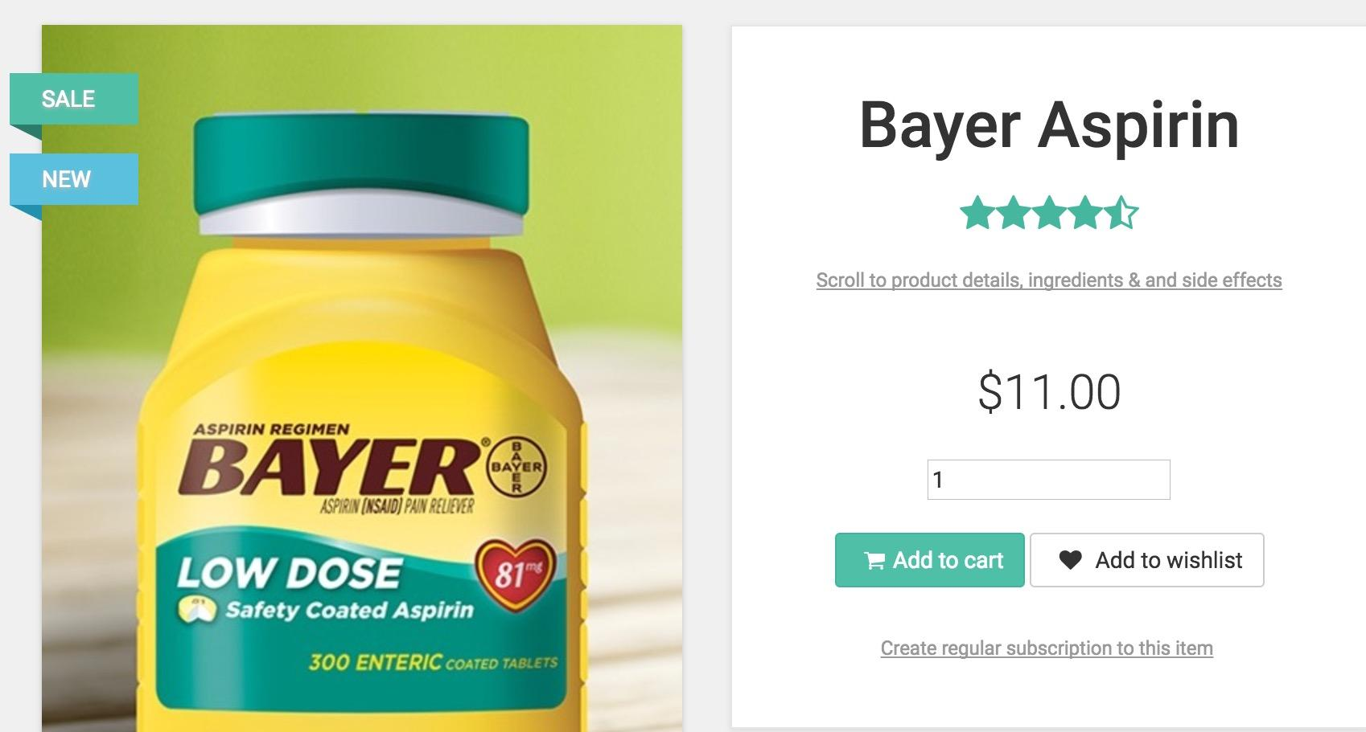
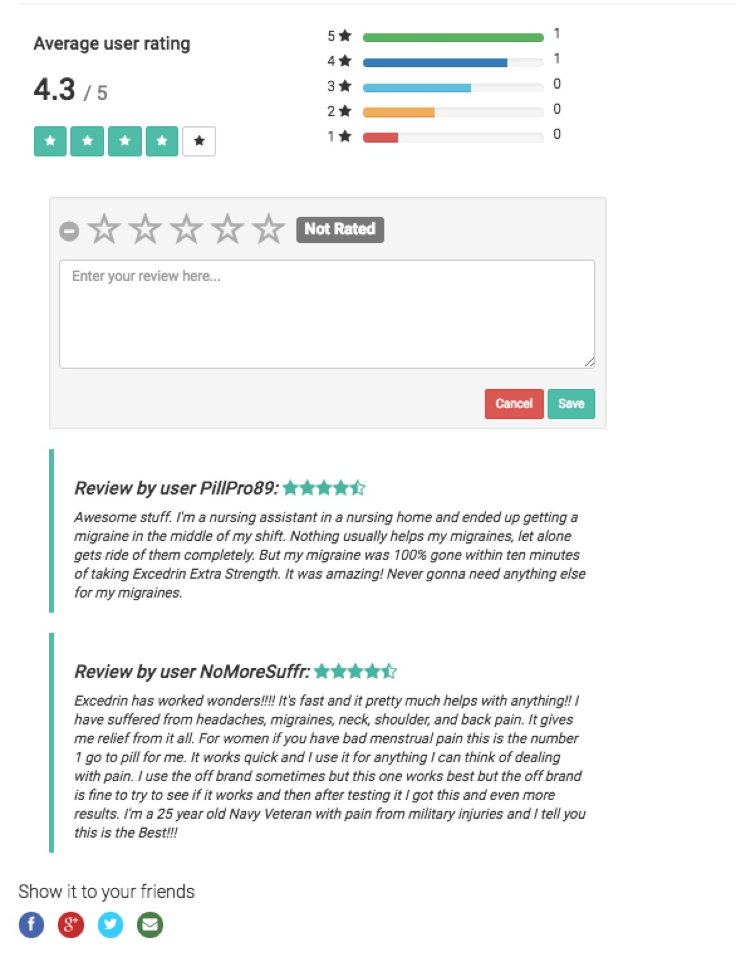
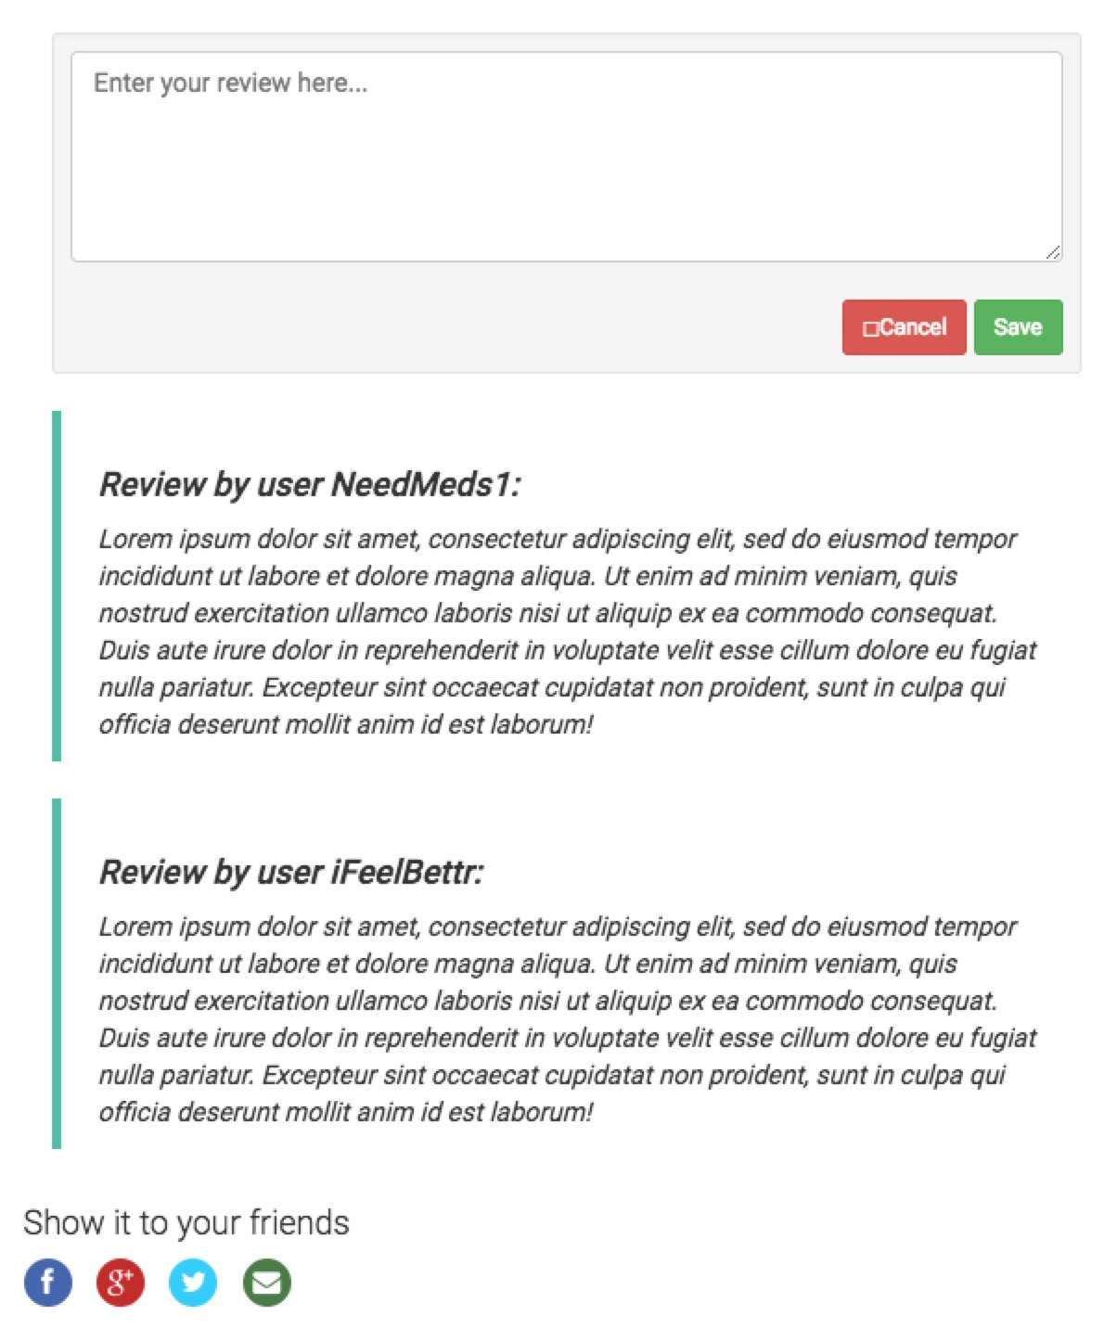
Product Page
Have No ratings
Notes:
Reviews are present for each product but ratings are not specified. Easy understandability of the product is ensured if rating is present.
It is not that critical, because on the reading the reviews eventually users can figure it out, but it will be easier for user if rating is provided.

Slide 13
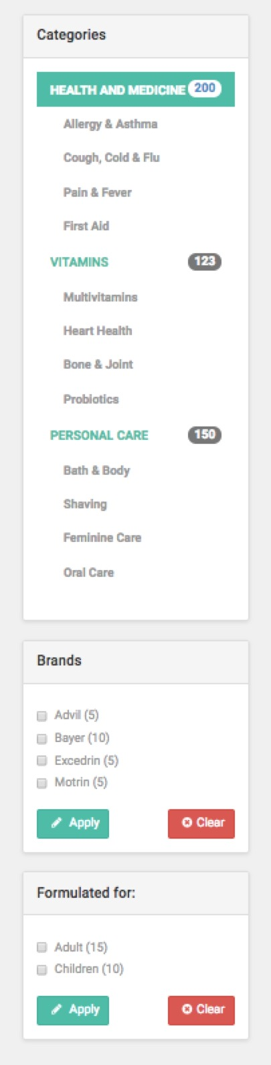
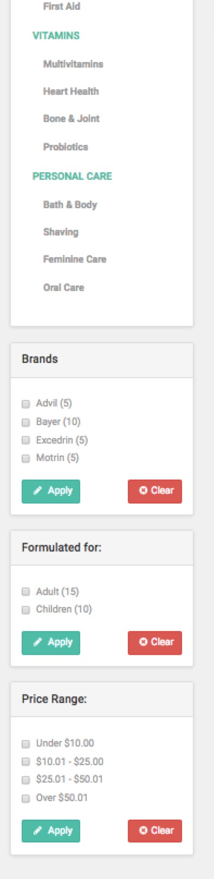
Category Page
It will be better if user can filter medicines by price range.
Notes:
Users do not need to know how many medications they have in each categroy.

Slide 14

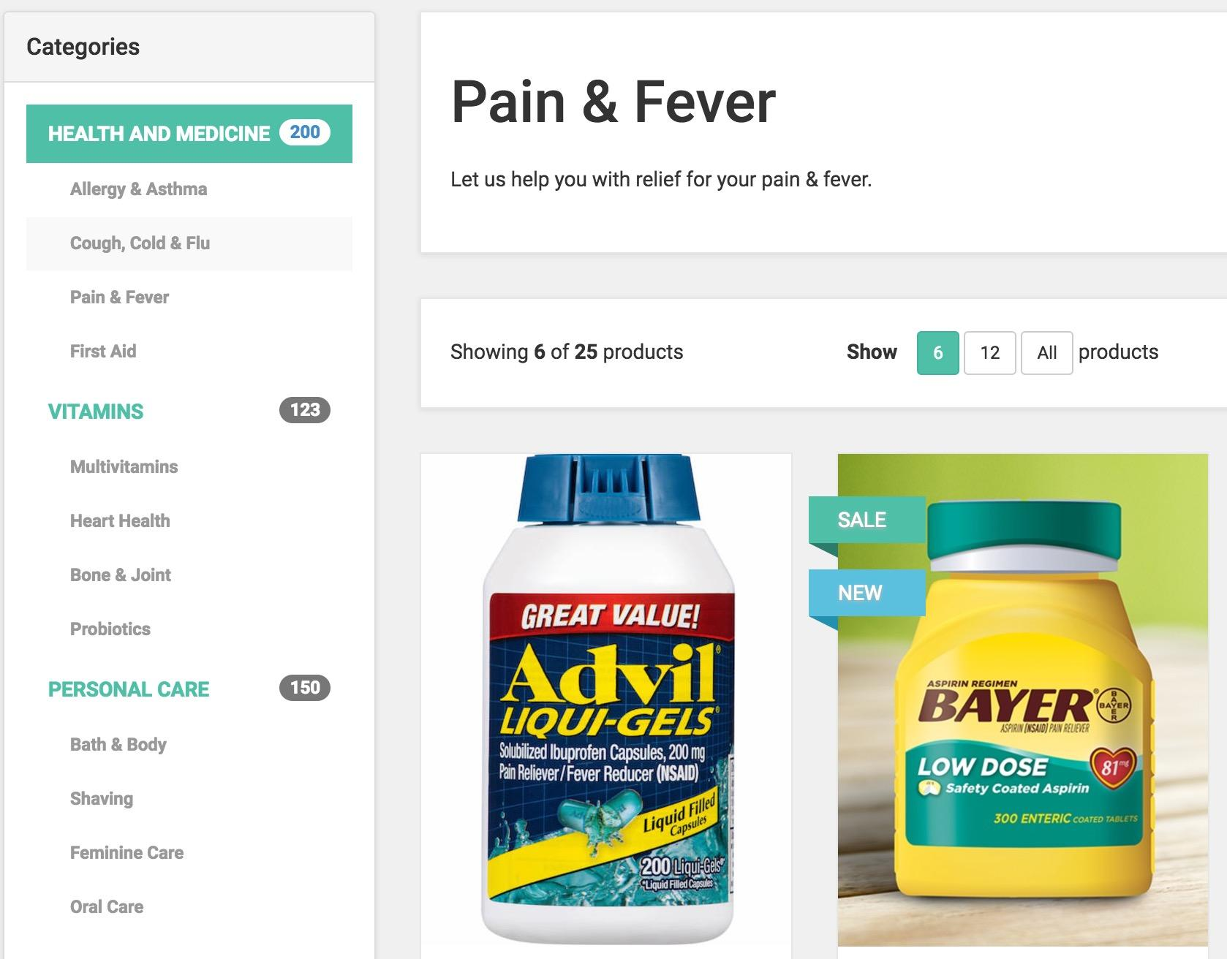
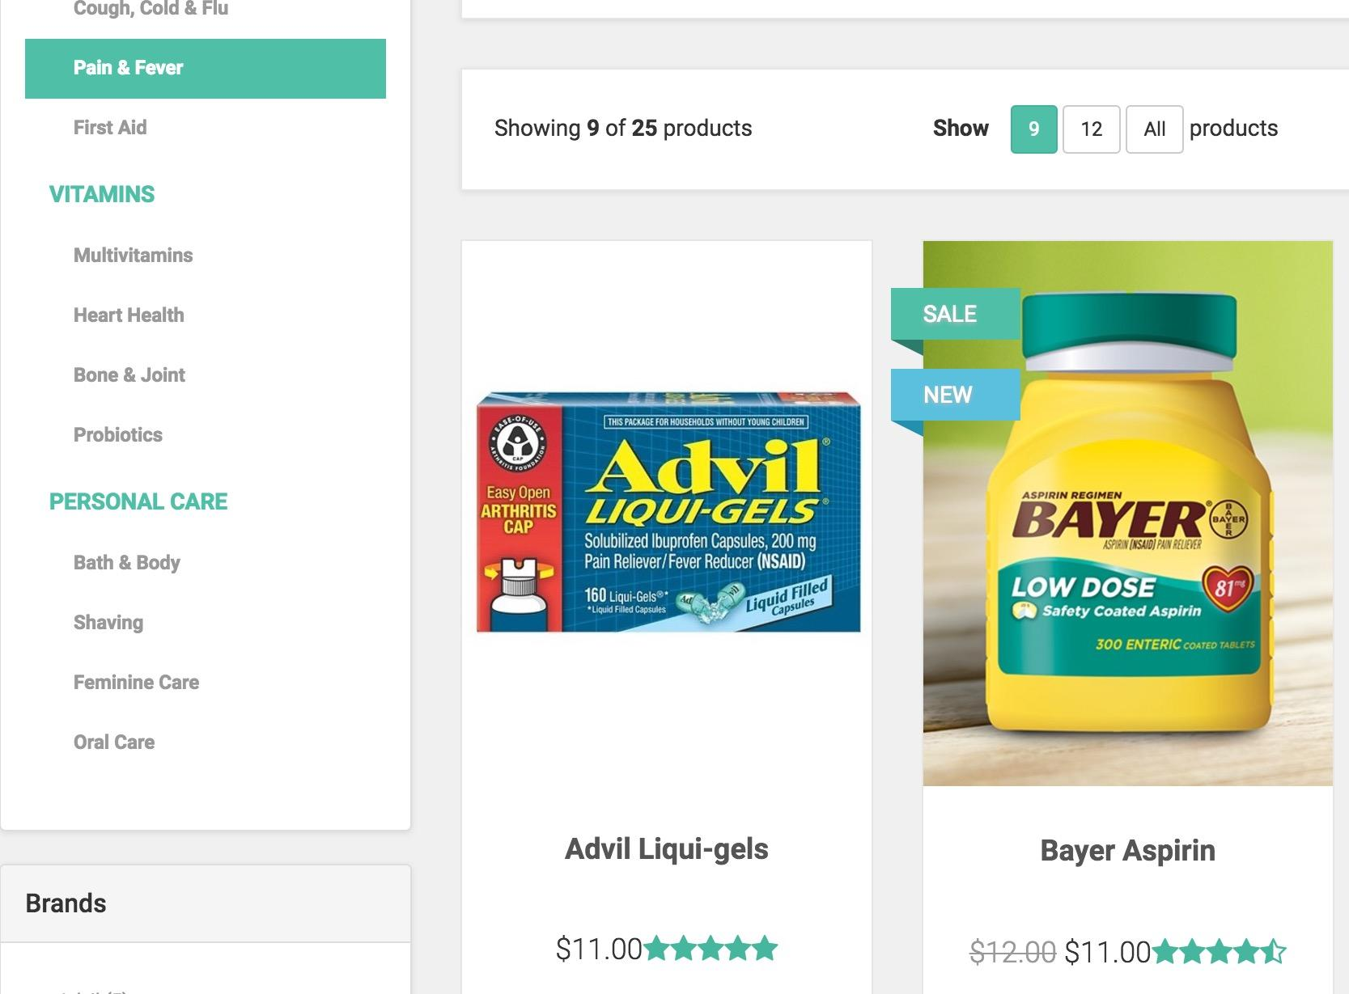
Category Page
It is unecessary to show numbers on the left category.
Notes:
Users do not need to know how many medications they have in each categroy.

Slide 15
Summary
4
What we have learned from this project

Slide 16
Four main principles:
1. Minimise the steps for users to achieve certain goals.
2. Provide more information for users to have confidence in their decision.
3. Provide functions that user expects.
4. Remove irrelevant information.
Notes:
1.Search bar
2.Rating and reviews
3.Filter the choice by price range
4.Number of medicine

Slide 17
Thanks !
Q&A

